Slide 1

ARCH & GARCH Models
Dr. Abolfazl Saghafi
Assistant Professor of Statistics & Data Science
Notes:
This week we explore ARCH & GARCH methods to model variation in time series. These techniques are used to assess risk and have widespread applications in finance.

Slide 2
ARCH & GARCH Models
• ARCH & GARCH models are used when assumption of constant variance is violated.
ARMA models focus on how to predict the conditional mean of future values based on current and past data.
• These models do not generally lead to better point forecasts of the time series but may lead to more reliable prediction intervals and thus a better assessment of risk.
Various problems such as option pricing in ﬁnance have motivated the study of the volatility or variability of a time series that provides a measure of the risk of an asset.
Models such as the Autoregressive Conditionally Heteroscedastic (ARCH) & Generalized ARCH (GARCH) are developed in 1982 & 1986 to model changes in volatility.
• Plotting absolute value or squared value of TS better illustrates volatility over time
• McLeod-Li test helps revealing existence of ARCH structure

Slide 3
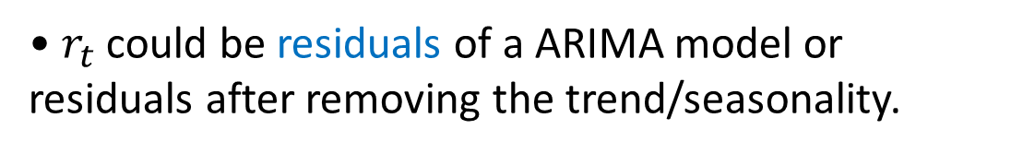
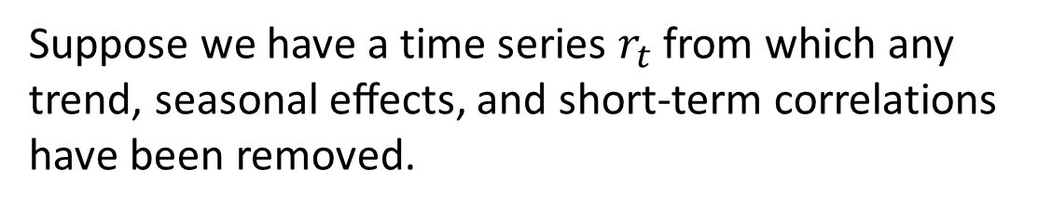

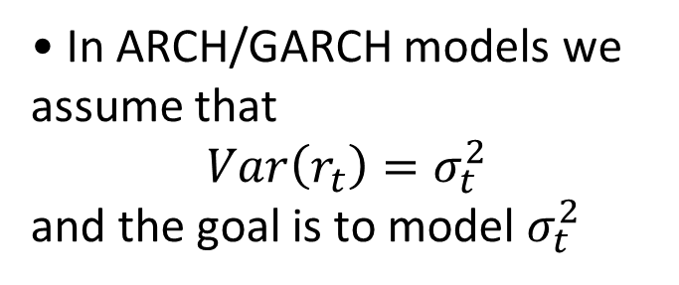
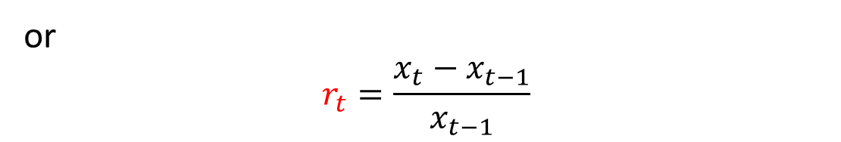
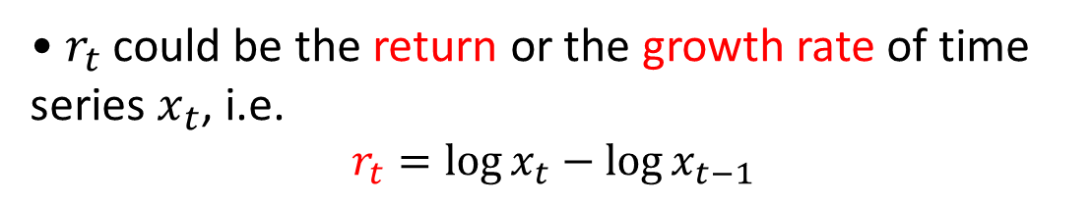
Return & Growth Rate
• One of the assumptions for residuals is that they have a constant variance, that is
$$Var\left(ε_{t}\right)=σ^{2}$$
Suppose we have a time series $r_{t}$ from which any trend, seasonal eﬀects, and short-term correlations have been removed.
• In ARCH/GARCH models we assume that
$$Var\left(r_{t}\right)=σ_{t}^{2}$$
and the goal is to model $σ_{t}^{2}$
• $r_{t}$ could be residuals of a ARIMA model or residuals after removing the trend/seasonality.
• $r_{t}$could be the return or the growth rate of time series $x_{t}$, i.e.
$$r_{t}=\log{x_{t}}−\log{x_{t−1}}$$
• When the return represents a small in magnitude percentage change, which is the case in many situations, then the two formulas become equivalent
or
$$r_{t}=\frac{x_{t}−x_{t−1}}{x_{t−1}}$$

Slide 4
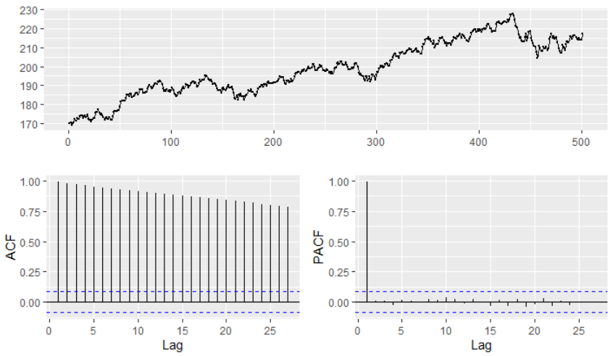
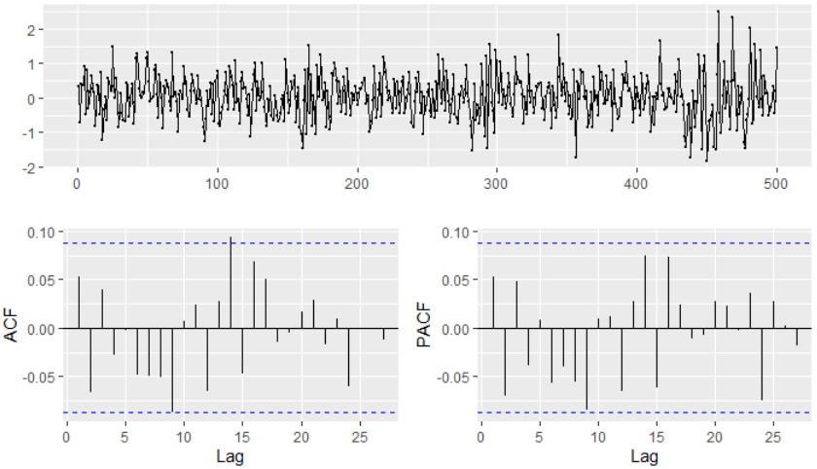
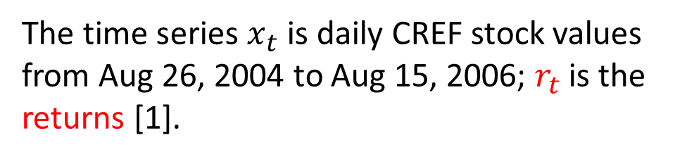


Example 1
$$x_{t}$$
The time series $x_{t}$ is daily CREF stock values from Aug 26, 2004 to Aug 15, 2006; $r_{t}$ is the returns [1].
Time plot reveals that the returns were more volatile over some time periods and became very volatile toward the end of the study period.
$$r_{t}$$
The ACF/PACF of returns suggest no signiﬁcant serial correlations. So, a white noise could be a proper fit for the mean of the returns, but values of returns violate constant variance assumption & normality.
[1] Cryer & Chan, Time Series Analysis: with Applications in R, Springer, 2008.
Notes:
The high volatility near the end of study period might be triggered by the instability in the Middle East due to a war in southern Lebanon from July 12 to August 14, 2006. The change in volatility could be more clearly seen by plotting the time plot of the absolute or squared returns.
Although the ACF/PACF of returns show non-correlation, the volatility change gives us a hint that the values may not be independent and identically distributed. If return values are truly independent and identically distributed, then nonlinear transformations such as taking logarithms, absolute values, or squaring preserves independence.

Slide 5
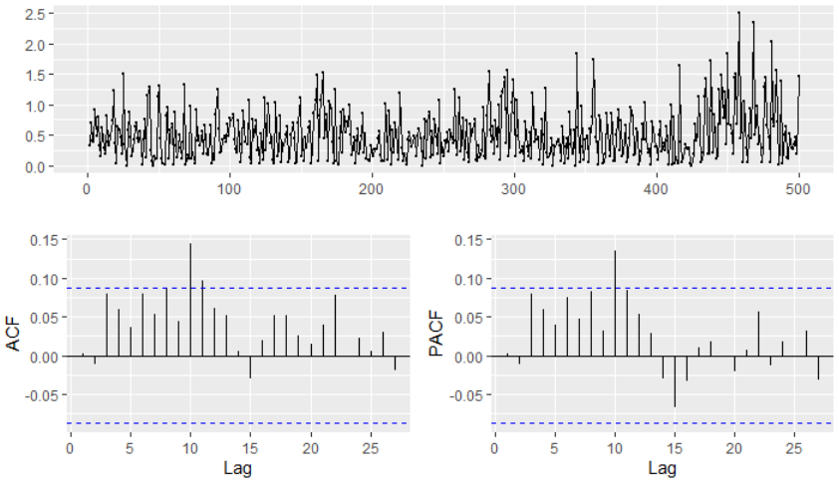
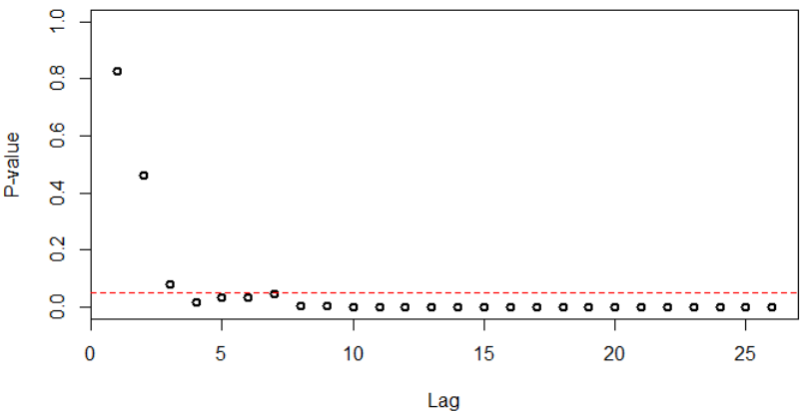
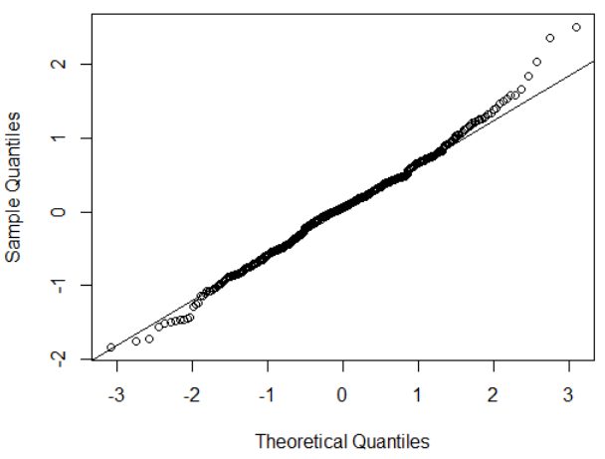

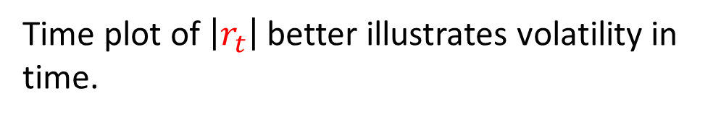
Time plot of $\left|r_{t}\right|$ better illustrates volatility in time.
The ACF/PACF of the absolute returns (or squared returns) display some significant autocorrelations and hence provide evidence that the daily returns are not independently and identically distributed.
The McLeod-Li tests are all significant at the 5% sign. level when more than 3 lags are included in the test, showing strong evidence for ARCH in returns data.
Moreover, Shapiro-Wilk rejects normality assumption of returns. Distribution of returns is skewed, with heavy-tail since kurtosis is positive (0.63).
Notes:
The ACF/PACF of the absolute returns (or squared returns) display some significant autocorrelations and hence provide evidence that the daily returns are not independently and identically distributed. These visual tools are often supplemented by some tests.
In summary, the CREF return data are found to be serially uncorrelated but admit a higher-order dependence structure, namely volatility clustering, and a heavy-tailed distribution. It is commonly observed that such characteristics are rather prevalent among financial time series data. The GARCH models introduced in the next sections attempt to provide a framework for modeling and analyzing time series that display some of these characteristics.

Slide 6
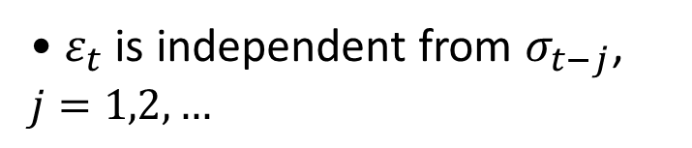
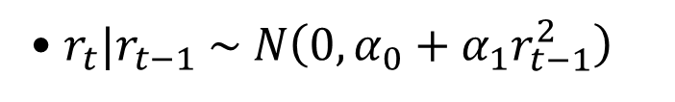
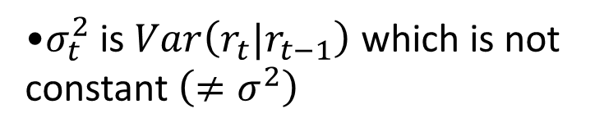

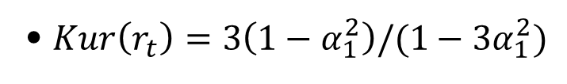
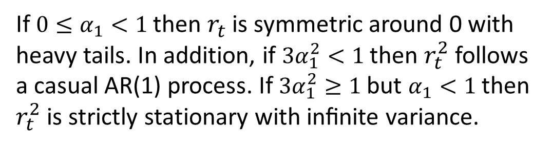
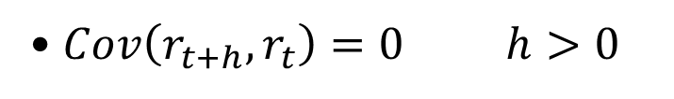
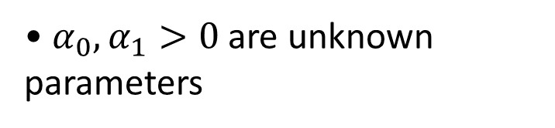
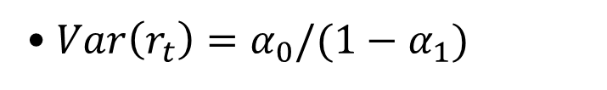

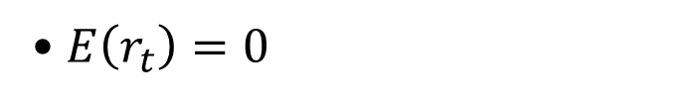
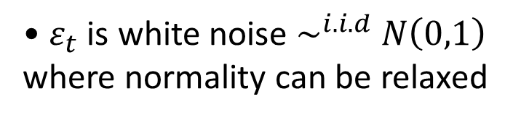
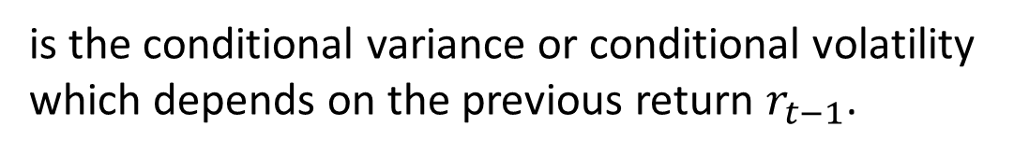
ARCH(1)
• $ε_{t}$ is white noise $\sim ^{i.i.d} N\left(0,1\right)$ where normality can be relaxed
• $α_{0},α_{1}>0$ are unknown parameters
The first-order ARCH model for $σ_{t}$ assumes
$$r_{t}=σ_{t} ε_{t}$$
•$σ_{t}^{2}$ is $Var\left(r_{t}|r_{t−1}\right)$ which is not constant $\left(≠σ^{2}\right)$
where $σ_{t}^{2}=α_{0}+α_{1}r_{t−1}^{2}$
is the conditional variance or conditional volatility which depends on the previous return $r_{t−1}$.
• $ε_{t}$ is independent from $σ_{t−j}$, $j=1,2,…$
Subtracting the two equations, it can be written as
$$r_{t}^{2}=α_{0}+α_{1}r_{t−1}^{2}−υ_{t}$$
• $r_{t}|r_{t−1} \sim N\left(0,α_{0}+α_{1}r_{t−1}^{2}\right)$
where $υ_{t}=σ_{t}^{2}\left(ε_{t}^{2}−1\right)$.
• $E\left(r_{t}\right)=0$
If ${0≤α}_{1}<1$ then $r_{t}$ is symmetric around 0 with heavy tails. In addition, if $3α_{1}^{2}<1$ then $r_{t}^{2}$ follows a casual AR(1) process. If $3α_{1}^{2}≥1$ but $α_{1}<1$ then $r_{t}^{2}$ is strictly stationary with inﬁnite variance.
• $Var\left(r_{t}\right)=α_{0}/(1−α_{1})$
• $Cov\left(r_{t+h},r_{t}\right)=0$ $h>0$
• $Kur\left(r_{t}\right)=3\left(1−α_{1}^{2}\right)/(1−3α_{1}^{2})$
Notes:
Because $ε_{t}^{2}$ is the square of a N(0,1) random variable, $ε_{t}^{2}−1$ is a shifted (to have zero mean), $χ_{1}^{2}$ random variable.
The kurtosis is never smaller than 3, the kurtosis of the normal distribution. Thus, the marginal distribution of the returns, rt, is leptokurtic, or has “fat tails.
Summarizing, if 0≤α1< 1, the process rt itself is white noise and its unconditional distribution is symmetrically distributed around zero; this distribution has heavy tails. If, in addition, 3α12<1, the square of the process, r2t, follows a causal AR(1) model. If 3α1 ≥ 1, but α1 < 1, it can be shown that r2 t is strictly stationary with inﬁnite variance.
Parameters in ARCH models can be estimated by maximum likelihood method, which usually needs to be done numerically.

Slide 7
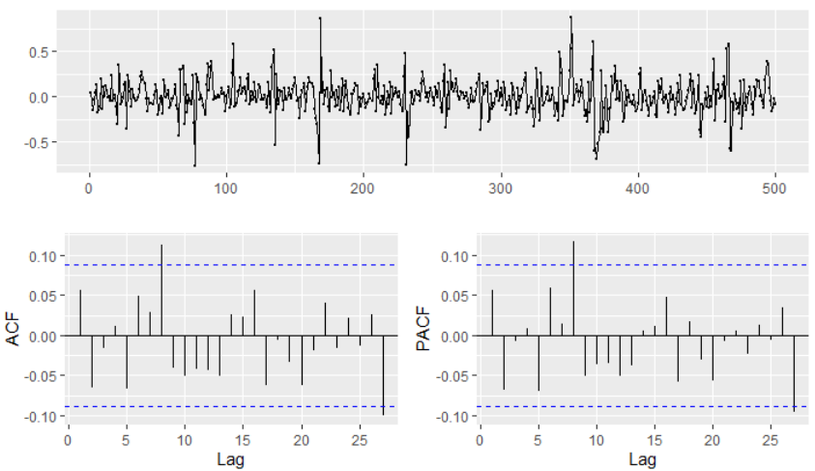
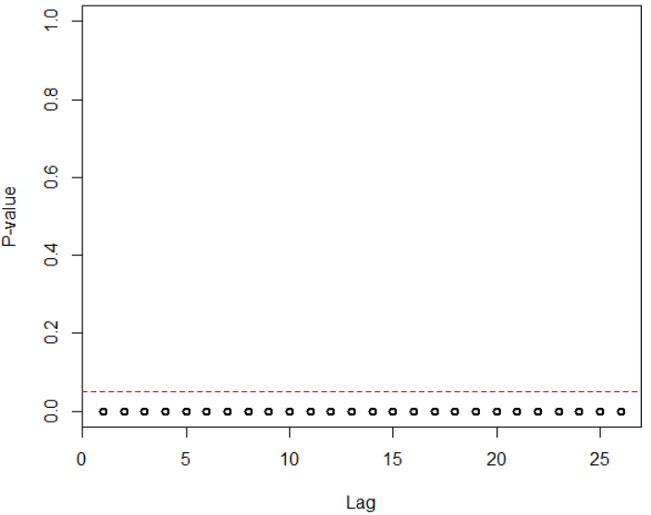
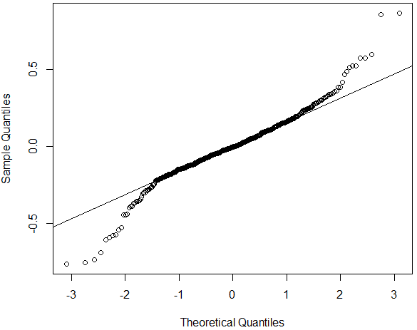


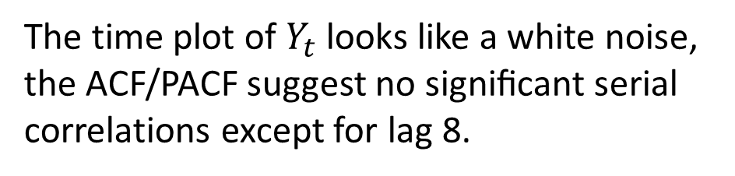
Example 2
$$Y_{t}$$
The time plot of $Y_{t}$ looks like a white noise, the ACF/PACF suggest no signiﬁcant serial correlations except for lag 8.
McLeod-Li tests are all significant at the 5% sign. level, showing strong evidence for an ARCH model.
Shapiro-Wilk rejects assumption of normality. Distribution of returns is heavily skewed.
Notes:
At this point we are convinced that serial correlation exists in the data but it’s not revealing itself in the ACF/PACF plots. If $Y_{t}$ was residuals of an ARIMA model, they do not satisfy the required conditions, we should try to model them using ARCH models.

Slide 8
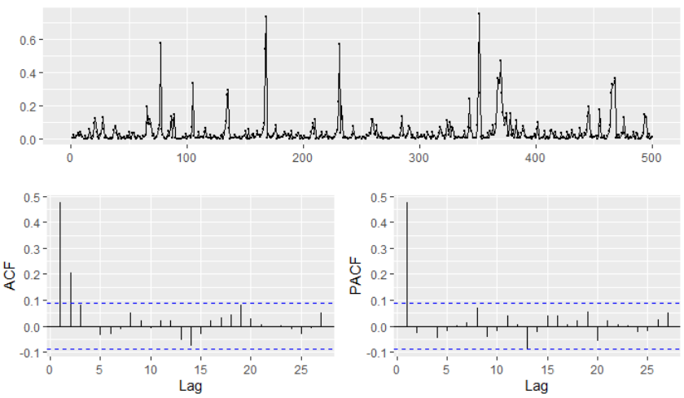
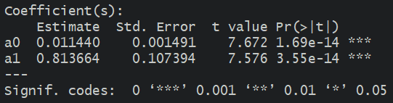

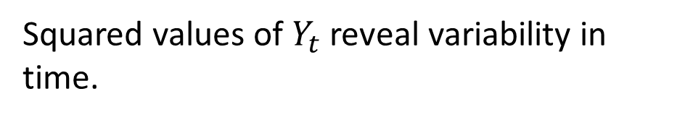

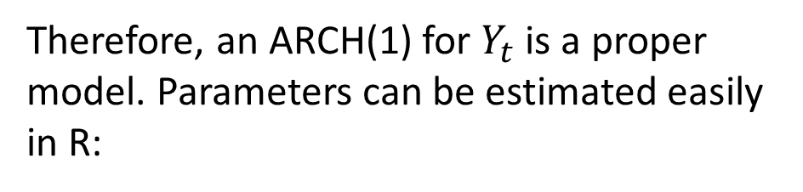
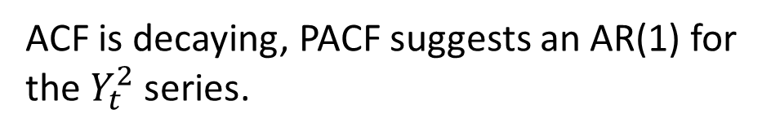
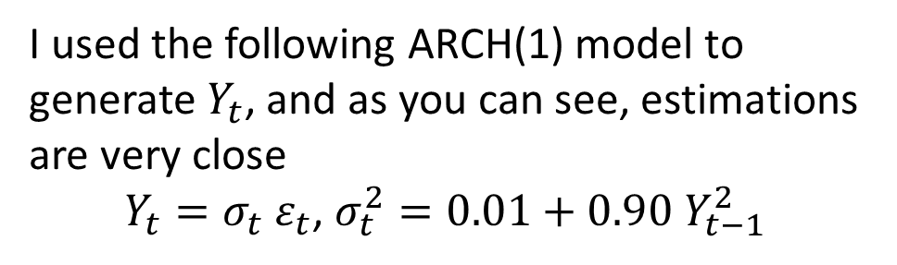
Squared values of $Y_{t}$ reveal variability in time.
$$Y_{t}^{2}$$
ACF is decaying, PACF suggests an AR(1) for the $Y_{t}^{2}$ series.
Therefore, an ARCH(1) for $Y_{t}$ is a proper model. Parameters can be estimated easily in R:
Box-Ljung test of lack of fit and model adequacy are provided in summary results that validate the fitted model (large p-value).
I used the following ARCH(1) model to generate $Y_{t}$, and as you can see, estimations are very close
$Y_{t}=σ_{t} ε_{t}$, $σ_{t}^{2}=0.01+0.90 Y_{t−1}^{2}$

Slide 9
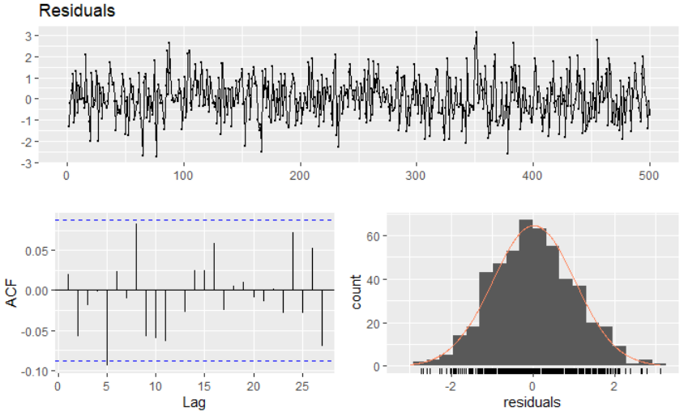
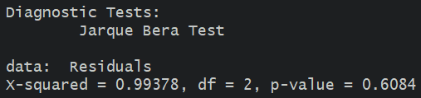
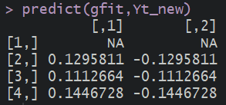
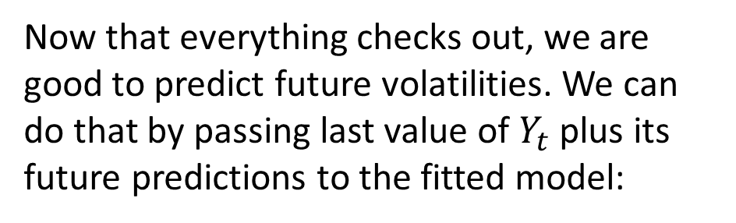
Residual analysis must be performed on the residuals of this model to confirm the four assumptions.
The four assumptions are confirmed using visual tools and tests.
Jarque Bera test of normality confirms normal distribution of residuals.
Now that everything checks out, we are good to predict future volatilities. We can do that by passing last value of $Y_{t}$ plus its future predictions to the fitted model:
Forecasts for three future values of $σ_{t}$ are:

Slide 10
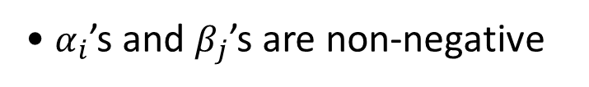

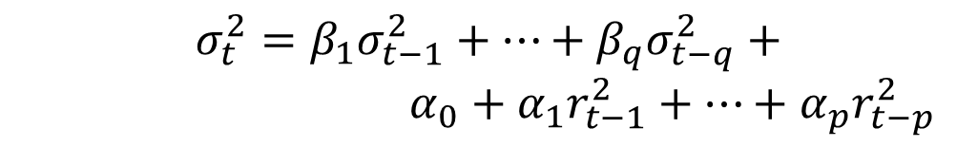
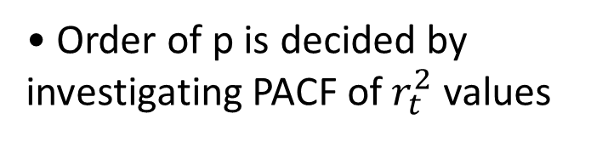
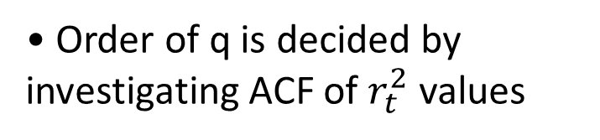
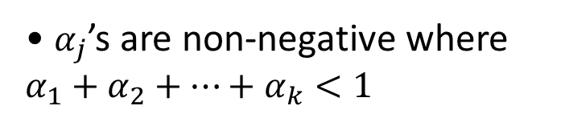
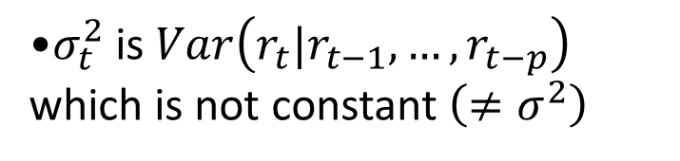
ARCH(p) & GARCH(q,p)
• $ε_{t}$ is white noise $\sim ^{i.i.d} N\left(0,1\right)$ where normality can be relaxed
• $α_{j}$’s are non-negative where $α_{1}+α_{2}+…+α_{k}<1$
Including further lagged squared returns in the ARCH(1) model results in ARCH(p)
•$σ_{t}^{2}$ is $Var\left(r_{t}|r_{t−1},…,r_{t−p}\right)$ which is not constant $\left(≠σ^{2}\right)$
$$r_{t}=σ_{t} ε_{t}$$
where $σ_{t}^{2}=α_{0}+α_{1}r_{t−1}^{2}+…+α_{p}r_{t−p}^{2}$
• $ε_{t}$ is independent from $σ_{t−j}$, $j=1,2,…$
The GARCH(q,p) assumes
$$σ_{t}^{2}=β_{1}σ_{t−1}^{2}+…+β_{q}σ_{t−q}^{2}+$$
$α_{0}+α_{1}r_{t−1}^{2}+…+α_{p}r_{t−p}^{2}$
• $α_{i}$’s and $β_{j}$’s are non-negative
The same invertibility and stationarity assumptions of ARMA models apply to GARCH models.
• Order of p is decided by investigating PACF of $r_{t}^{2}$ values
• Order of q is decided by investigating ACF of $r_{t}^{2}$ values
Notes:
Note that in some of the literature, the notation GARCH(q,p) is written as GARCH(p,q); that is, the orders are switched.
In practice, things won’t always fall into place as nicely as they do for simulated examples. You might have to experiment with various ARCH and GARCH structures after spotting the need in the time series plot of the series.

Slide 11
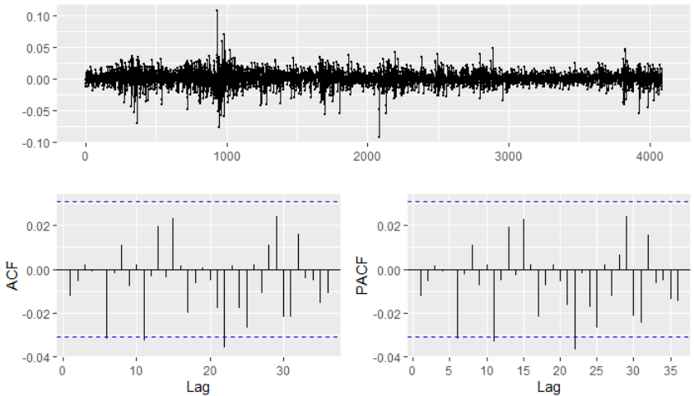

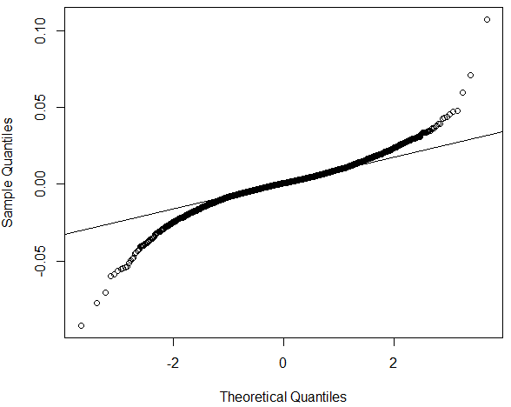
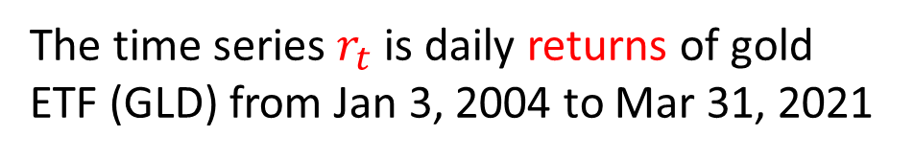

Example 3
$$r_{t}$$
The time series $r_{t}$ is daily returns of gold ETF (GLD) from Jan 3, 2004 to Mar 31, 2021
Looking at time plot, variability does not seem to be constant in time. ACF/PACF suggest no signiﬁcant serial correlations.
McLeod-Li tests are all significant at the 5% sign. level for all lags.
QQ-plot shows heavy-tail distribution for returns, assumption of normality is violated.
These are all strong evidence for an ARCH/GARCH model.
Notes:
At this point we should consider ARCH & GARCH methods for modeling volatility.

Slide 12
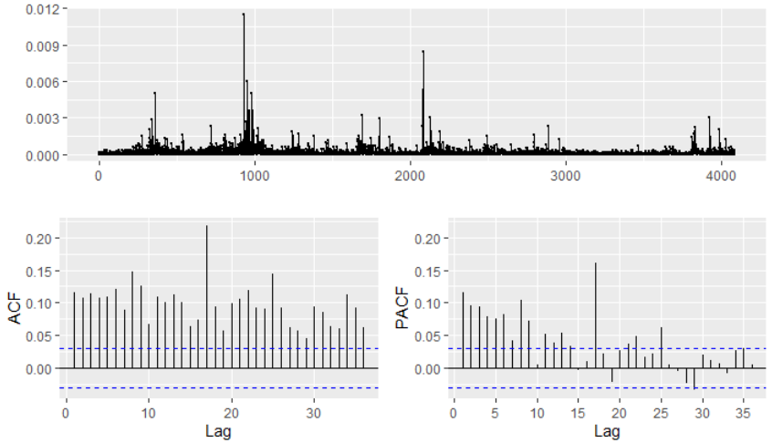
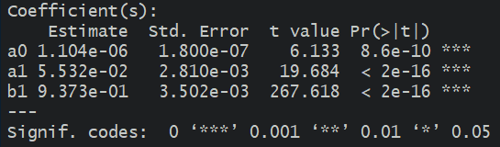


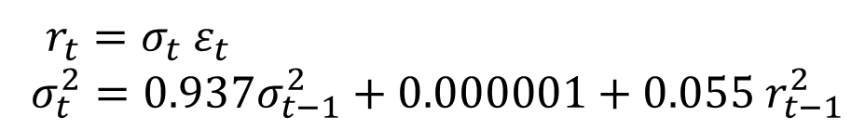

Squared values of $r_{t}$ also reveals variability in time.
$$r_{t}^{2}$$
ACF/PACF plot don’t suggest a pure AR or MA pattern, therefore, a GARCH model should be considered.
Best –log-likelihood is achieved for a GARCH(1,1) model, so we continue by fitting GARCH(1,1) and estimate model as:
$r_{t}=σ_{t} ε_{t}$
$σ_{t}^{2}=0.937σ_{t−1}^{2}+0.000001+0.055 r_{t−1}^{2}$
Box-Ljung test of lack of fit validates the model adequacy (p-value greater than 0.05).

Slide 13





Residual analysis confirms uncorrelated values, constant variance & zero mean.
Normal distribution of residuals is not confirmed but we decide to utilize the model. Histogram does look normal.

Slide 14



The plot of returns along with their estimated volatility using the GARCH(1,1) model illustrates how the model has captured volatility clustering of return values.
Forecasts for two future values of $σ_{t}$ are derived after passing the current return and two future returns to predict function

Slide 15





Example 4
$$r_{t}$$
The plot shows daily returns of Dow Jones Industrial Average (DJIA) from Mar 20 2006 to Mar 20, 2016
Variability ($σ_{t}$) is not constant in time. ACF/PACF shows some signiﬁcant serial correlations.
McLeod-Li tests are all significant at the 5% sign. level for all lags.
QQ-plot shows heavy-tail distribution for returns, assumption of normality is violated.
We should consider ARCH & GARCH methods for modeling volatility.

Slide 16






Plot of $r_{t}^{2}$ also reveals variability in time.
$$r_{t}^{2}$$
ACF/PACF plot don’t suggest a pure AR or MA pattern, therefore, a GARCH model should be considered.
Best -log-likelihood is achieved for a GARCH(1,2) model, so we continue by fitting GARCH(1,2) and estimate model as:
$r_{t}=σ_{t} ε_{t}$
$σ_{t}^{2}=0.83 σ_{t−1}^{2}+0.000003$
$+0.03 r_{t−1}^{2}+0.11 r_{t−2}^{2}$
Box-Ljung test of lack of fit validates the model adequacy (large p-value).

Slide 17



Residual analysis confirms uncorrelated values, zero mean & constant variance.
Although Bartel’s test reject randomness and ACF shows some correlation, the autocorrelations are very small and McLeod-Li test confirms insignificant values of autocorrelations for any lags.
The plot of returns and estimated volatility using the GARCH(1,2) model illustrates how the model has captured volatility clustering of return values.
Notes:
Normality assumption is rejected but this assumption can be relaxed, it does not affect the point estimations.

Slide 18

Practice Problems
1. Weekly crude oil spot prices in dollars per barrel are available after running library(astsa) and data(oil) in R [3]. Investigate whether the returns of the weekly oil price exhibits GARCH behavior.
2. Run data(EuStockMarkets) in R to have acquire daily closing prices of four major European stock indices. Fit a GARCH model to the returns of one of the series and discuss your ﬁndings. Note that you must first compute returns using provided closing prices.
3. Simulate 3000 instances of a GARCH(1,1), GRACH(1,2), and GARCH(2,1) models and investigate their properties using the techniques leaned in this week. Provide forecasts for the next 3 instances of $σ_{t}$ using your estimated model.
[3] Shumway & Stoffer, Time Series Analysis and Its Applications with R Examples, 4th Edition, Springer, 2017.

